Slide 1
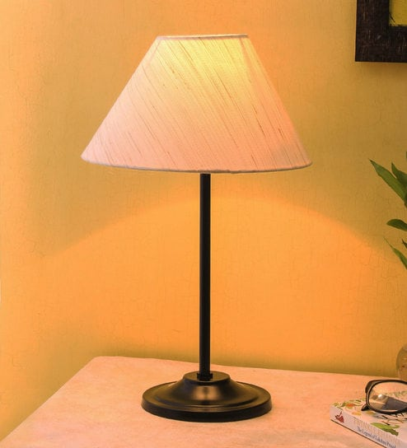
WELCOME
Mobile And Application Development

Slide 2

Sending Email in Android
Mobile And Application Development
Practical
Instructor: Muhammad Naeem Khan

Slide 3
SENDING Email
Basically Intent is a simple message object that is used to communicate between android components such as activities, content providers, broadcast receivers, and services, here use to send the email. This application basically contains one activity with EditText to take input of email address, subject, and body of the email from the user and button to send that email.

Slide 4
STEPS
Step 1: Create a New Project in Android Studio
To create a new project in Android Studio please refer to How to Create/Start a New Project in Android Studio.
Step 2: Working with the XML Files
Next, go to the activity_main.xml file, which represents the UI of the project. Below is the code for the activity_main.xml file. Comments are added inside the code to understand the code in more detail. This file contains a Relative Layout which contains three Edit texts for receiver mail id, another for the subject of the mail, and last one for the body of the email, and three TextViews for the label and a button for starting intent or sending mail:

Slide 5
activity_main.xml
<?xml version="1.0" encoding="utf-8"?> <RelativeLayout xmlns:android="http://schemas.android.com/apk/res/android" xmlns:tools="http://schemas.android.com/tools" android:layout_width="match_parent" android:layout_height="match_parent" android:background="@color/white" tools:context=".MainActivity"> <EditText android:id="@+id/editText1" android:layout_width="200dp" android:layout_height="wrap_content" android:layout_alignParentTop="true" android:layout_alignParentEnd="true" android:layout_marginTop="100dp" android:layout_marginEnd="22dp" /> <EditText android:id="@+id/editText2" android:layout_width="200dp" android:layout_height="wrap_content" android:layout_below="@+id/editText1" android:layout_alignStart="@+id/editText1" android:layout_marginTop="20dp" /> | <EditText android:id="@+id/editText3" android:layout_width="200dp" android:layout_height="wrap_content" android:layout_below="@+id/editText2" android:layout_alignStart="@+id/editText2" android:layout_marginTop="30dp" /> <TextView android:id="@+id/textView1" android:layout_width="wrap_content" android:layout_height="wrap_content" android:padding="16dp" android:textSize="18sp" android:textStyle="bold" android:layout_alignBaseline="@+id/editText1" android:layout_alignBottom="@+id/editText1" android:layout_alignParentStart="true" android:text="Send To:" android:textColor="@color/green" />

Slide 6
activity_main.xml
<TextView android:id="@+id/textView2" android:layout_width="wrap_content" android:layout_height="wrap_content" android:padding="16dp" android:textSize="18sp" android:textStyle="bold" android:layout_alignBaseline="@+id/editText2" android:layout_alignBottom="@+id/editText2" android:layout_alignParentStart="true" android:text="Email Subject:" android:textColor="@color/green" /> <TextView android:id="@+id/textView3" android:layout_width="wrap_content" android:layout_height="wrap_content" android:padding="16dp" android:textSize="18sp" android:textStyle="bold" | android:layout_alignBaseline="@+id/editText3" android:layout_alignBottom="@+id/editText3" android:text="Email Body:" android:textColor="@color/green" /> <Button android:id="@+id/button" android:layout_width="wrap_content" android:layout_height="wrap_content" android:layout_below="@+id/editText3" android:layout_centerHorizontal="true" android:textSize="24sp" android:layout_marginTop="20dp" android:backgroundTint="@color/green" android:text="Send email!!" /> </RelativeLayout>

Slide 7
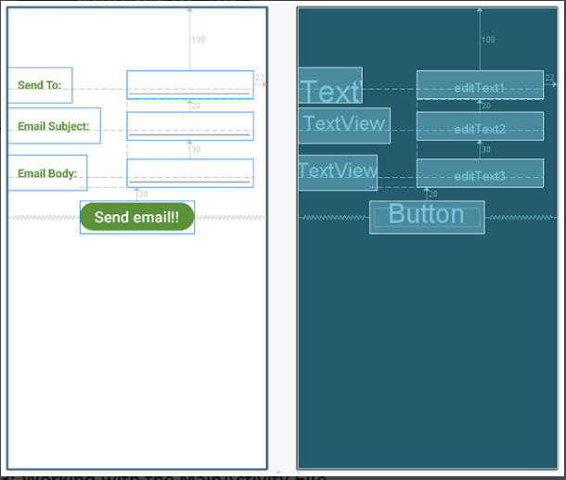
activity_main.xml

Slide 8
Java code
package org.geeksforgeeks.demo; import android.content.Intent; import android.os.Bundle; import android.view.View; import android.widget.Button; import android.widget.EditText; import androidx.appcompat.app.AppCompatActivity; public class MainActivity extends AppCompatActivity { // Declare EditText and Button objects private Button button; private EditText sendTo; private EditText subject; private EditText body; @Override protected void onCreate(Bundle savedInstanceState) { super.onCreate(savedInstanceState); setContentView(R.layout.activity_main); // Initialize EditText and Button sendTo = findViewById(R.id.editText1); subject = findViewById(R.id.editText2); body = findViewById(R.id.editText3); button = findViewById(R.id.button); | // Set OnClickListener for the button button.setOnClickListener(new View.OnClickListener() { @Override public void onClick(View v) { String emailSend = sendTo.getText().toString(); String emailSubject = subject.getText().toString(); String emailBody = body.getText().toString(); // Define Intent object with action attribute as ACTION_SEND Intent intent = new Intent(Intent.ACTION_SEND); // Add email details using putExtra intent.putExtra(Intent.EXTRA_EMAIL, new String[]{emailSend}); intent.putExtra(Intent.EXTRA_SUBJECT, emailSubject); intent.putExtra(Intent.EXTRA_TEXT, emailBody);

Slide 9
Java code
// Set the type of intent intent.setType("message/rfc822"); // Start the activity with a chooser for email clients startActivity(Intent.createChooser(intent, "Choose an Email client :")); } }); } }

Slide 10
Thank You

